Slide 1

CARDIOTOCOGRAM ANALYSIS TO IMPROVE MATERNAL AND FETAL HEALTH OUTCOMES THROUGH MACHINE LEARNING
Presented by-
Pavan Marturu
Priya kaur
Lithika Sreedhar

Slide 2
CARDIOTOCOGRAM
Cardiotocography (CTG) is employed throughout pregnancy to monitor both fetal heart rate and uterine contractions. Its primary purpose is to assess fetal well-being and enable early detection of any signs of fetal distress.
Interpreting CTG results aids in evaluating the risk level associated with the pregnancy. An abnormal CTG reading may signify the necessity for additional investigations and potential intervention to address any underlying concerns.
Cardiotocograms (CTGs) offer a straightforward and affordable means to evaluate fetal health, empowering healthcare providers to intervene effectively to prevent maternal and infant mortality. This equipment operates by emitting ultrasound pulses and analyzing their feedback, providing insights into fetal heart rate (FHR), fetal movements, uterine contractions, and other vital parameters.

Slide 3
Fetal Heart Rate (FHR) monitoring
Uterine Contractions (UC) monitoring
Graphical representation & Results

Slide 4
Clinical Significance of CTG monitoring
Early Detection of Fetal Stress
Assessment of Labor Progression
Evidence based Decision making
Better communication between Healthcare Providers

Slide 5
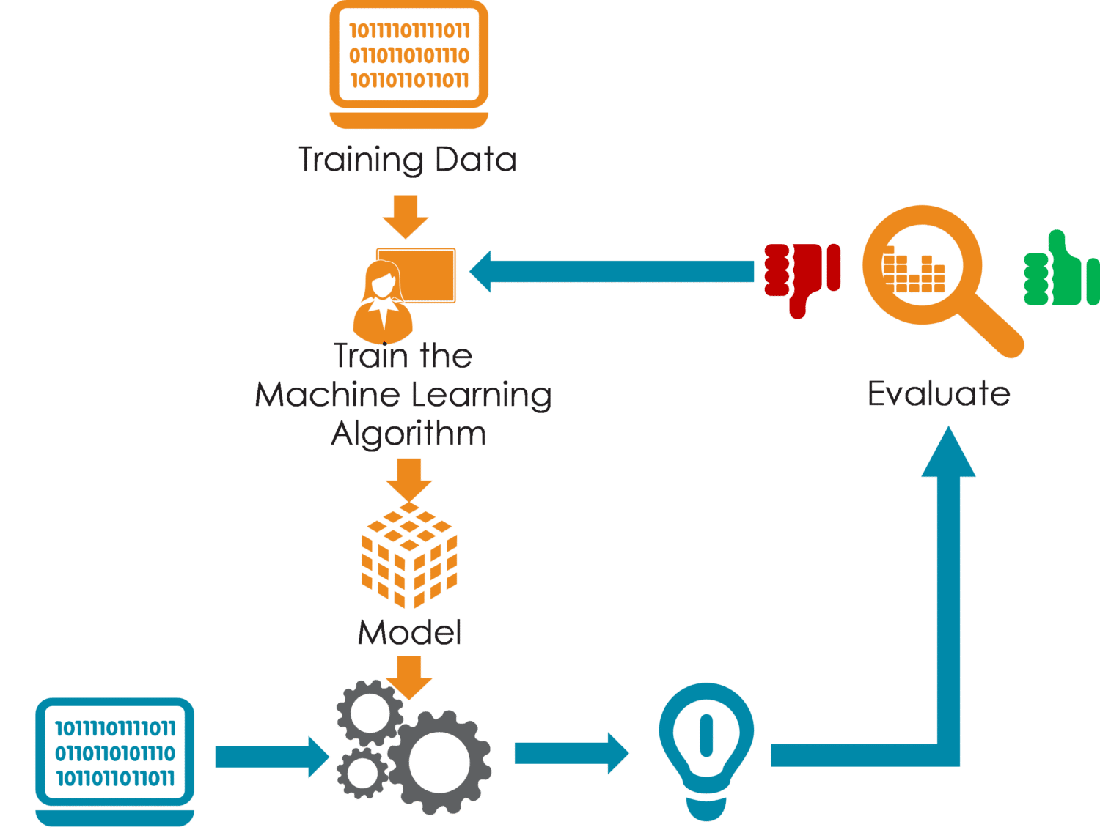
The aim of the machine learning methods is to use attributes of data obtained from the uterine contraction (UC) and fetal heart rate (FHR) signals to classify as: pathological normal

Slide 6
DATASET
DATASET OVERVIEW:
The dataset obtained from Kaggle comprises 2126 records with 22 extracted features.
These features serve as inputs for a multiclass classification task.
The classification targets are divided into three distinct classes.

Slide 7
DATASET
MULTI CLASS CLASSIFICATION :
Unlike binary classification, which involves distinguishing between two classes, multiclass classification involves predicting from multiple classes. In a multiclass classification problem, each instance typically belongs to one and only one class, and the model's objective is to correctly assign instances to their respective classes based on the features provided.

Slide 8
DATASET
HIGHLY IMBALANCE DATASET
In highly imbalanced datasets, the distribution of instances across classes is severely skewed, with one or a few classes significantly outnumbering others.

Slide 9
PHASES IN DATA ANALYSIS
organizing features (X) and defining the target variable (y).
Model Selection
Hyperparameter Tuning
Splitting the data to train and test sets
Scale the Features
DATA CLEANING
One of the strengths of our dataset is its completeness, as there are no missing values present. This eliminates the need for time-consuming data cleaning steps, allowing us to focus our efforts directly on feature engineering, model selection, and performance evaluation, thereby streamlining the machine learning workflow.

Slide 10
FEATURE SELCTION AND SCALING
In our analysis, we used all the 22 features available from the dataset to predict the target variable, fetal health. This variable is represented as follows: 1 for normal, 2 for suspect, and 3 for pathological cases.
Prior to scaling, visual representations may appear cluttered, with features exhibiting disparate scales. Following scaling, however, visualizations become more coherent, as all features are standardized to comparable scales. This fosters clearer insights into data relationships, facilitating more informed decision-making during model development and analysis.

Slide 11
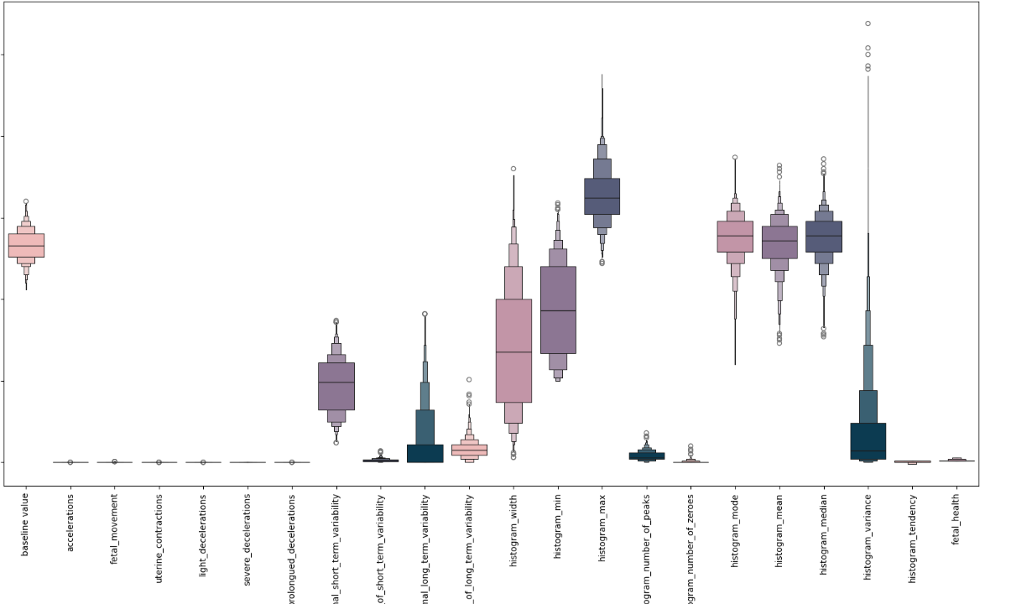
RANGE OF FEATURE ATTRIBUTES

Slide 12
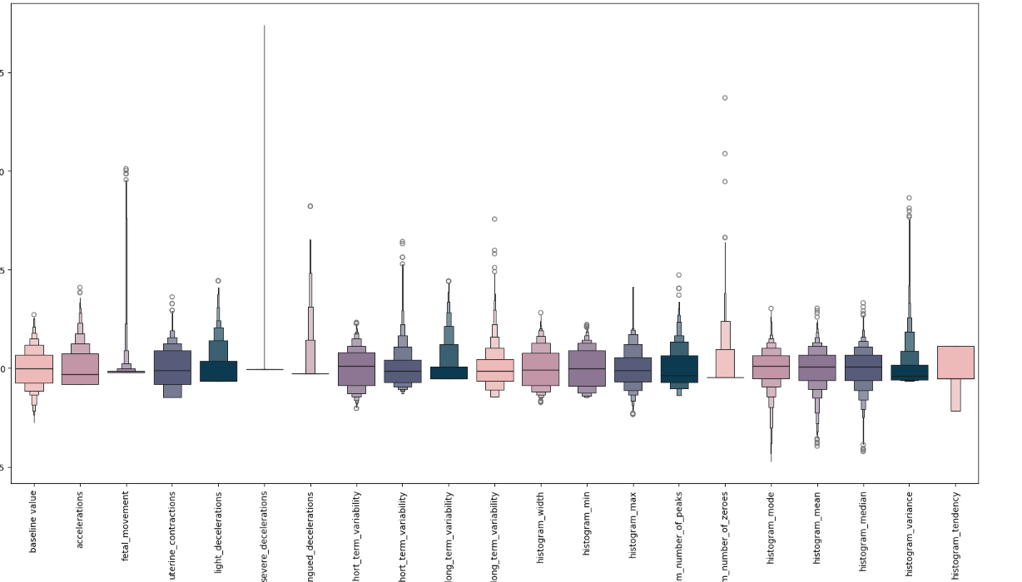
AFTER FEATURE SCALING

Slide 13
SPLITTING THE DATASET
DATASET
TRAINING
(80%)
TESTING
(20%)

Slide 14
MODEL SELECTION
DATA IMBALANCE
Stratified Cross-validation
Class weighting
HYPERPARAMETER TUNING
Grid Search
Random Forest
Support Vector Machine
Adaboost

Slide 15
METRICS
MODEL NAME | TRAINING ACCURACY | TESTING ACCRACY
Random Forest | 0.9395 | 0.9420
Support Vector Machine | 0.9220 | 0.9247
Adaboost | 0.9173 | 0.9122
Among the 3 classifiers, Random Forest achieved the highest accuracy

Slide 16
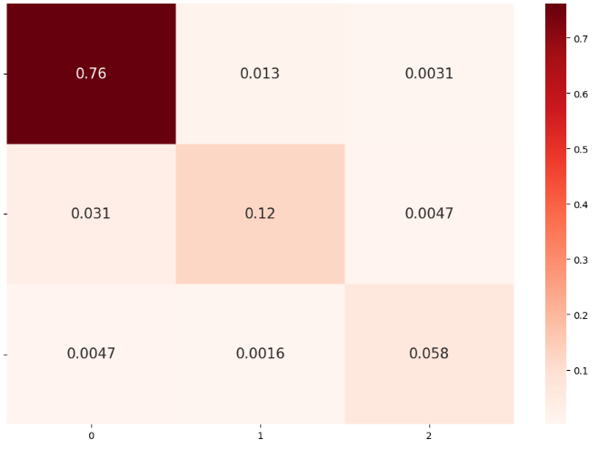
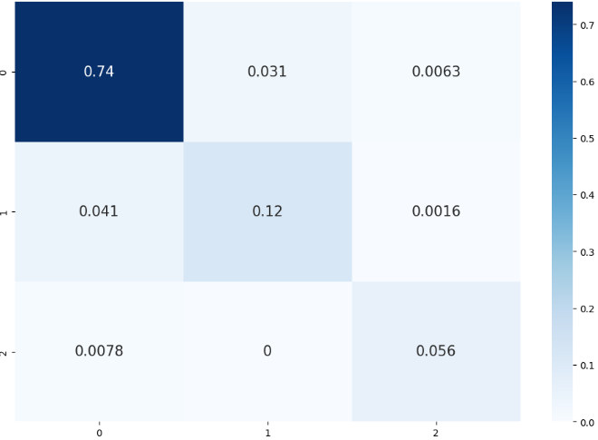
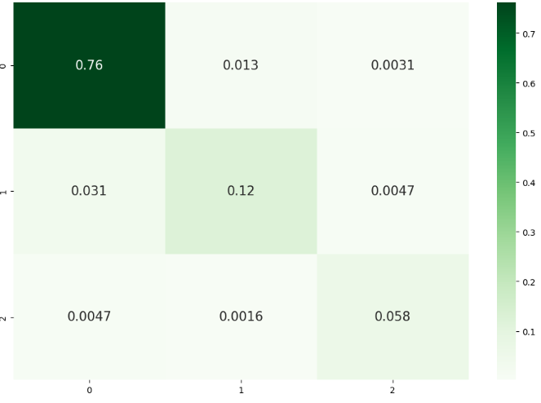
CONFUSION MATRIX
RANDOM FOREST
SVM
ADABOOST

Slide 17
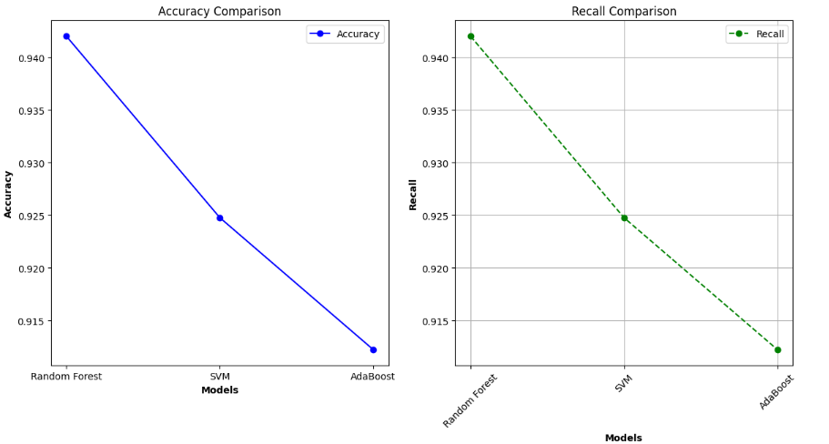
DATA VISUALISATION

Slide 18
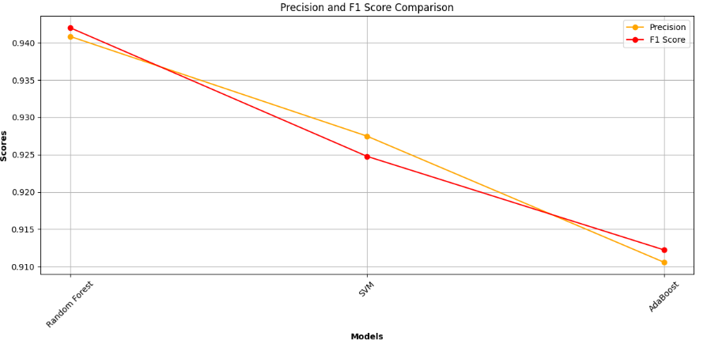
DATA VISUALISATION

Slide 19

REFERENCES
Dataset: Campos,D. and Bernardes,J.. (2010). Cardiotocography. UCI Machine Learning Repository. https://doi.org/10.24432/C51S4N.
Kuzu A, Santur Y. Early Diagnosis and Classification of Fetal Health Status from a Fetal cardiotocograpy dataset using ensemble learning. Diagnostics (Basel).2023 Jul doi: 25;13(15):2471.

Slide 20

Machine Learning: Redefining Healthcare, one algorithm at a time Thank You

